Slide 1
SSZG 518: Database Design and Applications
Today’s Class
SQL

Slide 2
Nested Subqueries
SQL provides a mechanism for the nesting of subqueries.
A subquery is a select-from-where expression that is nested within another query.
A common use of subqueries is to perform tests for set membership, set comparisons, and set cardinality.

Slide 3
What Is a Subquery?
A subquery is a SELECT statement embedded in a clause of another SQL statement.
Main
Query
SELECT . . .
FROM . . .
WHERE . . .
(SELECT . . .
FROM . . .
WHERE . . .)
Subquery

Slide 4
Subqueries
The subquery (inner query) executes once before the main query.
The result of the subquery is used by the main query (outer query).
SELECT select_list
FROM table
WHERE expr operator (SELECT select_list
FROM table);

Slide 5
Using a Subquery
SQL> SELECT ename
2 FROM emp
3 WHERE sal >
4 (SELECT sal
5 FROM emp
6 WHERE empno = 7566);
2975
ENAME
----------
KING
FORD
SCOTT
Notes:
SQL> CREATE TABLE dept_copy(deptno, dname, loc)
2 AS SELECT deptno, dname, loc
3 FROM dept;
SQL> SELECT ename, job, sal
2 FROM emp
3 WHERE sal < (SELECT AVG(sal)
4 FROM emp);

Slide 6
Correlated Subqueries
Used to affect row-by-row processing, each subquery is executed once for every row of the outer query.
GET
candidate row
EXECUTE
inner query using candidate row value
USE
value(s) from inner query to qualify candidate row

Slide 7
Correlated Subqueries
SELECT outer1, outer2, ...
FROM table1 alias1
WHERE outer1 operator
(SELECT inner1
FROM table2 alias2
WHERE alias1.outer2 = alias2.inner1);
The subquery references a column from a table in the parent query.

Slide 8
Using Correlated Subqueries
Find all employees who make more than the average salary in their department.
SQL> SELECT empno, sal, deptno
2 FROM emp outer
3 WHERE sal > (SELECT AVG(sal)
4 FROM emp inner
5 WHERE outer.deptno = inner.deptno);
Each time the outer query
is processed the
inner query is
evaluated.
EMPNO SAL DEPTNO
-------- --------- ---------
7839 5000 10
7698 2850 30
7566 2975 20
...
6 rows selected.

Slide 9
“In” Construct
Find all customers who have both an account and a loan at the bank.
select distinct customer_name from borrower where customer_name in (select customer_name from depositor )
Find all customers who have a loan at the bank but do not have an account at the bank
select distinct customer_name from borrower where customer_name not in (select customer_name from depositor )

Slide 10
Nested Queries
Find names of sailors who’ve reserved boat #103:
SELECT S.sname
FROM Sailors S
WHERE S.sid IN (SELECT R.sid
FROM Reserves R
WHERE R.bid=103)
A very powerful feature of SQL: a WHERE clause can itself contain an SQL query! (Actually, so can FROM and HAVING clauses.)
To find sailors who’ve not reserved #103, use NOT IN.
To understand semantics of nested queries, think of a nested loops evaluation: For each Sailors tuple, check the qualification by computing the subquery.

Slide 11
Example Query
Find all customers who have both an account and a loan at the Perryridge branch
select distinct customer_name from borrower, loan where borrower.loan_number = loan.loan_number and branch_name = 'Perryridge' and (branch_name, customer_name ) in (select branch_name, customer_name from depositor, account where depositor.account_number = account.account_number )
Note: Above query can be written in a much simpler manner. The formulation above is simply to illustrate SQL features.

Slide 12
“Some” Construct
Find all branches that have greater assets than some branch located in Brooklyn.
select distinct T.branch_name from branch as T, branch as S where T.assets > S.assets and S.branch_city = 'Brooklyn'
Same query using > some clause
select branch_name from branch where assets > some (select assets from branch where branch_city = 'Brooklyn')

Slide 13
“All” Construct
Find the names of all branches that have greater assets than all branches located in Brooklyn.
select branch_name from branch where assets > all (select assets from branch where branch_city = 'Brooklyn')

Slide 14
Nested Queries with Correlation
Find names of sailors who’ve reserved boat #103:
SELECT S.sname
FROM Sailors S
WHERE EXISTS (SELECT *
FROM Reserves R
WHERE R.bid=103 AND S.sid=R.sid)
EXISTS is another set comparison operator, like IN.

Slide 15
“Exists” Construct
Find all customers who have an account at all branches located in Brooklyn.
select distinct S.customer_name from depositor as S where not exists ( (select branch_name from branch where branch_city = 'Brooklyn') except (select R.branch_name from depositor as T, account as R where T.account_number = R.account_number and S.customer_name = T.customer_name ))

Slide 16
Division in SQL
(1)
SELECT S.sname
FROM Sailors S
WHERE NOT EXISTS
((SELECT B.bid
FROM Boats B)
EXCEPT
(SELECT R.bid
FROM Reserves R
WHERE R.sid=S.sid))
Find sailors who’ve reserved all boats.
Let’s do it the hard way, without EXCEPT:
(2)
SELECT S.sname
FROM Sailors S
WHERE NOT EXISTS (SELECT B.bid
FROM Boats B
WHERE NOT EXISTS (SELECT R.bid
FROM Reserves R
WHERE R.bid=B.bid
AND R.sid=S.sid))
Sailors S such that ...
there is no boat B without ...
a Reserves tuple showing S reserved B

Slide 17
Absence of Duplicate Tuples
The unique construct tests whether a subquery has any duplicate tuples in its result.
Find all customers who have at most one account at the Perryridge branch.
select T.customer_name
from depositor as T
where unique (
select R.customer_name from account, depositor as R where T.customer_name = R.customer_name and R.account_number = account.account_number and account.branch_name = 'Perryridge')

Slide 18
Example Query
Find all customers who have at least two accounts at the Perryridge branch.
select distinct T.customer_name
from depositor as T
where not unique (
select R.customer_name
from account, depositor as R
where T.customer_name = R.customer_name and
R.account_number = account.account_number and
account.branch_name = 'Perryridge')
Variable from outer level is known as a correlation variable

Slide 19
Derived Relations
SQL allows a subquery expression to be used in the from clause
Find the average account balance of those branches where the average account balance is greater than $1200.
select branch_name, avg_balance from (select branch_name, avg (balance) from account group by branch_name ) as branch_avg ( branch_name, avg_balance ) where avg_balance > 1200
Note that we do not need to use the having clause, since we compute the temporary (view) relation branch_avg in the from clause, and the attributes of branch_avg can be used directly in the where clause.

Slide 20
Find the maximum total balance across all branches.
Select max(tot_balance)
from ( select branch_name, sum(balance)
from account
group by branch_name) as branch_total(branch_name,tot_balance)

Slide 21
Null Values
It is possible for tuples to have a null value, denoted by null, for some of their attributes
null signifies an unknown value or that a value does not exist.
The predicate is null can be used to check for null values.
Example: Find all loan number which appear in the loan relation with null values for amount.
select loan_number from loan where amount is null
The result of any arithmetic expression involving null is null
Example: 5 + null returns null
However, aggregate functions simply ignore nulls

Slide 22
Null Values and Three Valued Logic
Any comparison with null returns unknown
Example: 5 < null or null <> null or null = null
Three-valued logic using the truth value unknown:
OR: (unknown or true) = true, (unknown or false) = unknown (unknown or unknown) = unknown
AND: (true and unknown) = unknown, (false and unknown) = false, (unknown and unknown) = unknown
NOT: (not unknown) = unknown
“P is unknown” evaluates to true if predicate P evaluates to unknown
Result of where clause predicate is treated as false if it evaluates to unknown

Slide 23
Null Values and Aggregates
Total all loan amounts
select sum (amount ) from loan
Above statement ignores null amounts
All aggregate operations except count(*) ignore tuples with null values on the aggregated attributes.

Slide 24
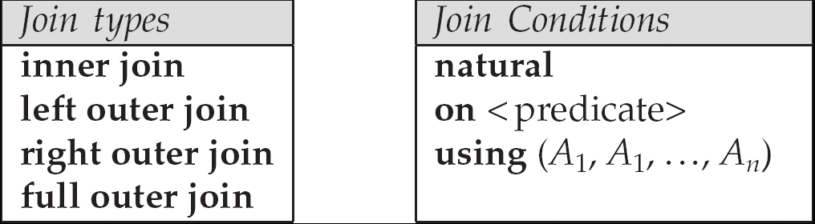
Joined Relations
Join operations take two relations and return as a result another relation.
These additional operations are typically used as subquery expressions in the from clause
Join condition – defines which tuples in the two relations match, and what attributes are present in the result of the join.
Join type – defines how tuples in each relation that do not match any tuple in the other relation (based on the join condition) are treated.

Slide 25
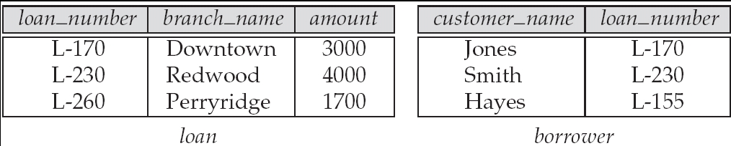
Joined Relations – Datasets for Examples
Relation loan
Relation borrower
Note: borrower information missing for L-260 and loan information missing for L-155

Slide 26
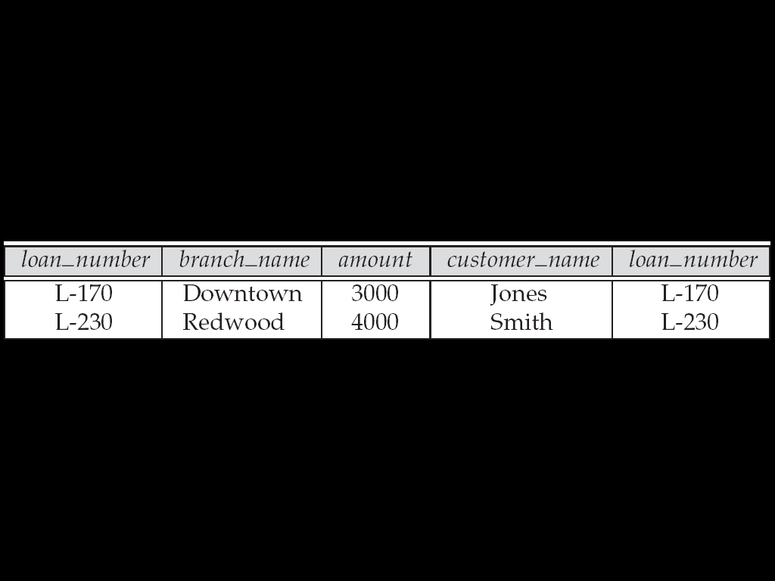
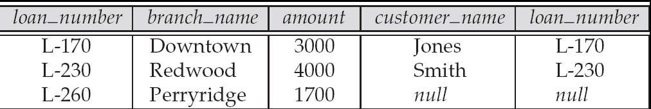
Joined Relations – Examples
loan inner join borrower on loan.loan_number = borrower.loan_number
loan left outer join borrower on loan.loan_number = borrower.loan_number

Slide 27
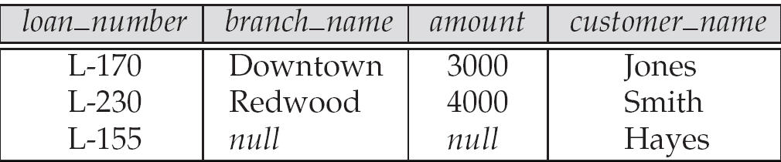
Joined Relations – Examples
loan natural inner join borrower
loan natural right outer join borrower
Find all customers who have either an account or a loan (but not both) at the bank.
select customer_name from (depositor natural full outer join borrower ) where account_number is null or loan_number is null

Slide 28
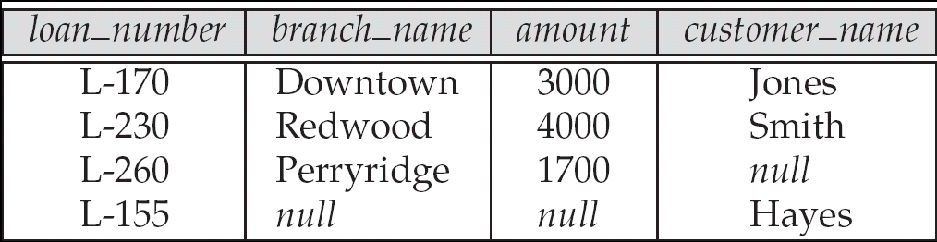
Joined Relations – Examples
Natural join can get into trouble if two relations have an attribute with same name that should not affect the join condition
e.g. an attribute such as remarks may be present in many tables
Solution:
loan full outer join borrower using (loan_number)

Slide 29
View Definition
A relation that is not of the conceptual model but is made visible to a user as a “virtual relation” is called a view.
A view is defined using the create view statement which has the form
create view v as < query expression >
where <query expression> is any legal SQL expression. The view name is represented by v.
Once a view is defined, the view name can be used to refer to the virtual relation that the view generates.

Slide 30
Example Queries
A view consisting of branches and their customers
create view all_customer as (select branch_name, customer_name from depositor, account where depositor.account_number = account.account_number )
union (select branch_name, customer_name from borrower, loan where borrower.loan_number = loan.loan_number )
Find all customers of the Perryridge branch
select customer_name from all_customer where branch_name = 'Perryridge'

Slide 31
Uses of Views
Hiding some information from some users
Consider a user who needs to know a customer’s name, loan number and branch name, but has no need to see the loan amount.
Define a view (create view cust_loan_data as select customer_name,borrower.loan_number, branch_name from borrower, loan where borrower.loan_number = loan.loan_number )
Grant the user permission to read cust_loan_data, but not borrower or loan
Predefined queries to make writing of other queries easier
Common example: Aggregate queries used for statistical analysis of data

Slide 32
Processing of Views
When a view is created
the query expression is stored in the database along with the view name
the expression is substituted into any query using the view
Views definitions containing views
One view may be used in the expression defining another view
A view relation v₁ is said to depend directly on a view relation v₂ if v₂ is used in the expression defining v₁
A view relation v₁ is said to depend on view relation v₂ if either v₁ depends directly to v₂ or there is a path of dependencies from v₁ to v₂
A view relation v is said to be recursive if it depends on itself.

Slide 33
View Expansion
A way to define the meaning of views defined in terms of other views.
Let view v₁ be defined by an expression e₁ that may itself contain uses of view relations.
View expansion of an expression repeats the following replacement step:
repeat Find any view relation v_{i} in e₁ Replace the view relation v_{i} by the expression defining v_{i} until no more view relations are present in e₁
As long as the view definitions are not recursive, this loop will terminate

Slide 34
With Clause
The with clause provides a way of defining a temporary view whose definition is available only to the query in which the with clause occurs.
Find all accounts with the maximum balance with max_balance (value) as select max (balance) from account select account_number from account, max_balance where account.balance = max_balance.value

Slide 35
Complex Queries using With Clause
Find all branches where the total account deposit is greater than the average of the total account deposits at all branches.
with branch_total (branch_name, value) as select branch_name, sum (balance) from account group by branch_name with branch_total_avg (value) as select avg (value) from branch_total select branch_name from branch_total, branch_total_avg where branch_total.value >= branch_total_avg.value
Note: the exact syntax supported by your database may vary slightly.
E.g. Oracle syntax is of the form with branch_total as ( select .. ), branch_total_avg as ( select .. ) select …

